Slide 1


Analysis of house price fluctuations in Hong Kong districts in 2014-2024
Xiyang Zhang
Hanmin Geng

Slide 2
Outline
Explain polar coordinates
Display our 4 params animals
Do South CN morning post scrape etc.
Present the groups and project ideas.

Slide 3
Brief Introduction

Slide 4
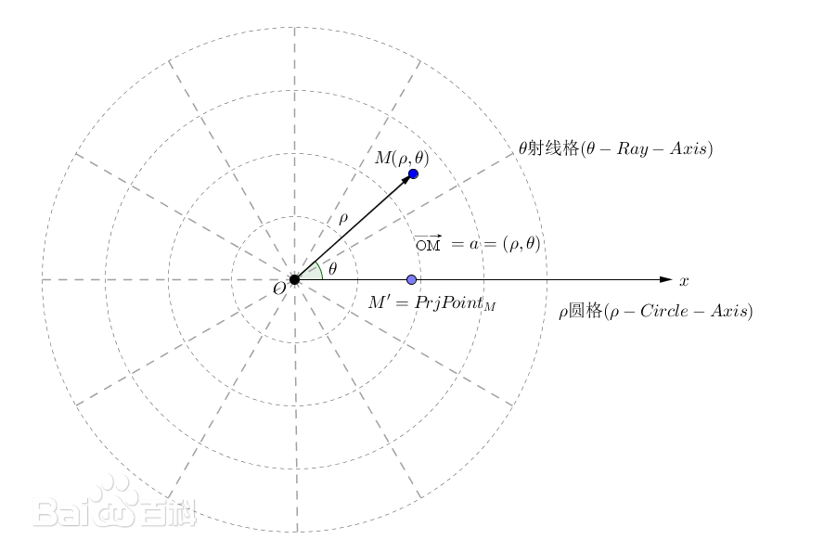
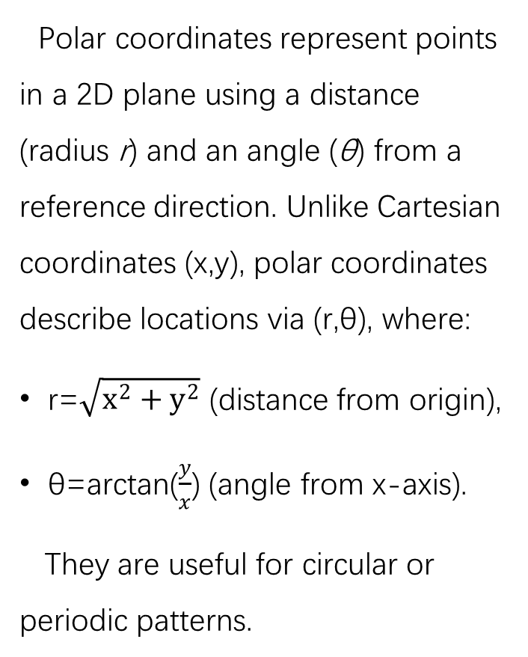
Explain Polar Coordinates
Polar coordinates represent points in a 2D plane using a distance (radius r) and an angle (θ) from a reference direction. Unlike Cartesian coordinates (x,y), polar coordinates describe locations via (r,θ), where:
r=$\sqrt{x^{2}+y^{2}}$​ (distance from origin),
θ=arctan⁡($\frac{y}{x}$) (angle from x-axis).
They are useful for circular or periodic patterns.

Slide 5
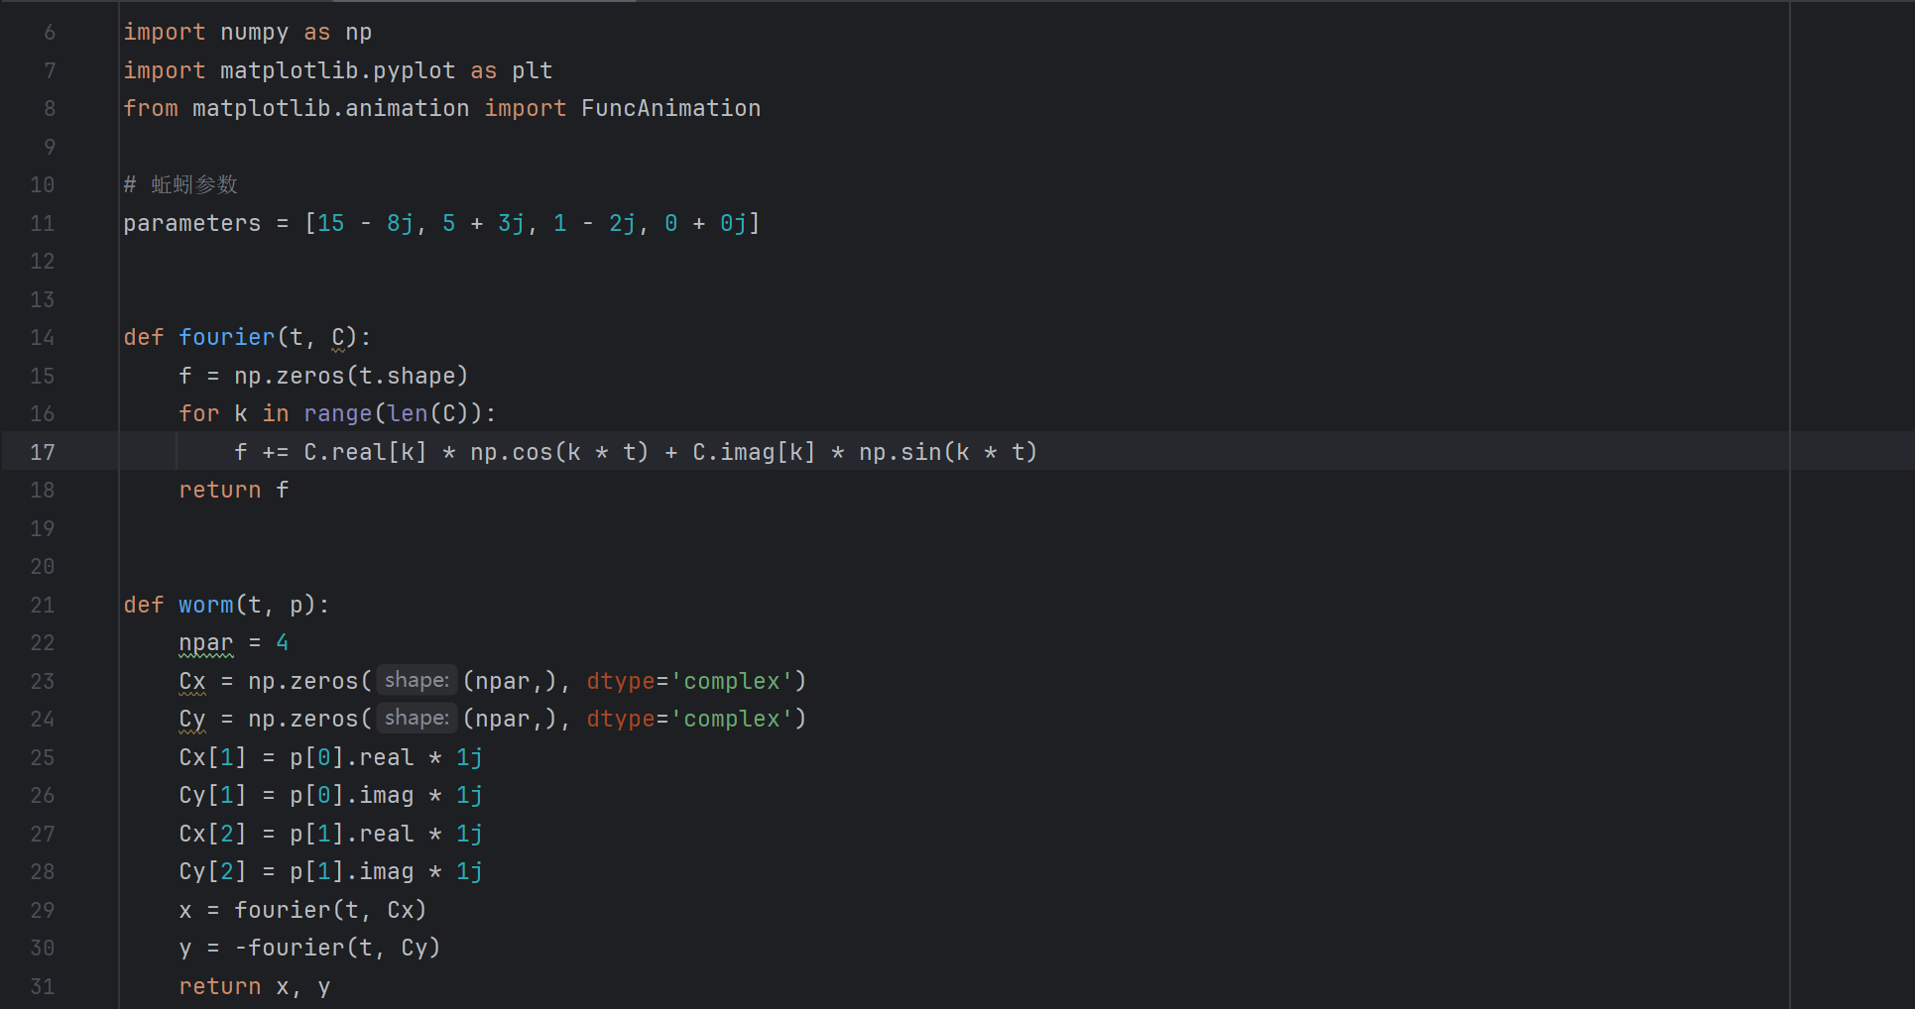
Display our 4 params animals by PyCharm
Fish or an earthworm?

Slide 6
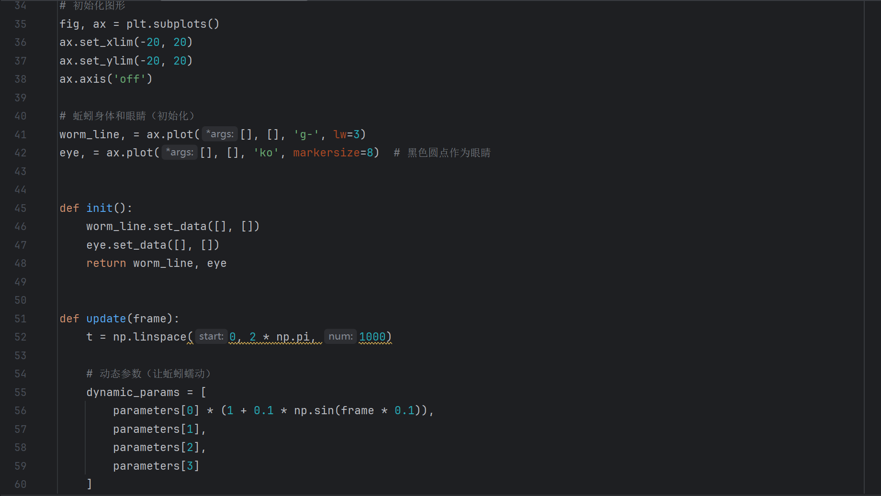
Display our 4 params animals by PyCharm

Slide 7
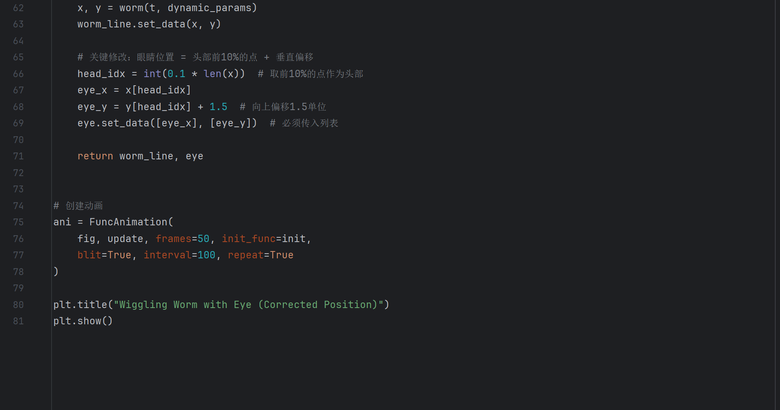
Display our 4 params animals by PyCharm

Slide 8
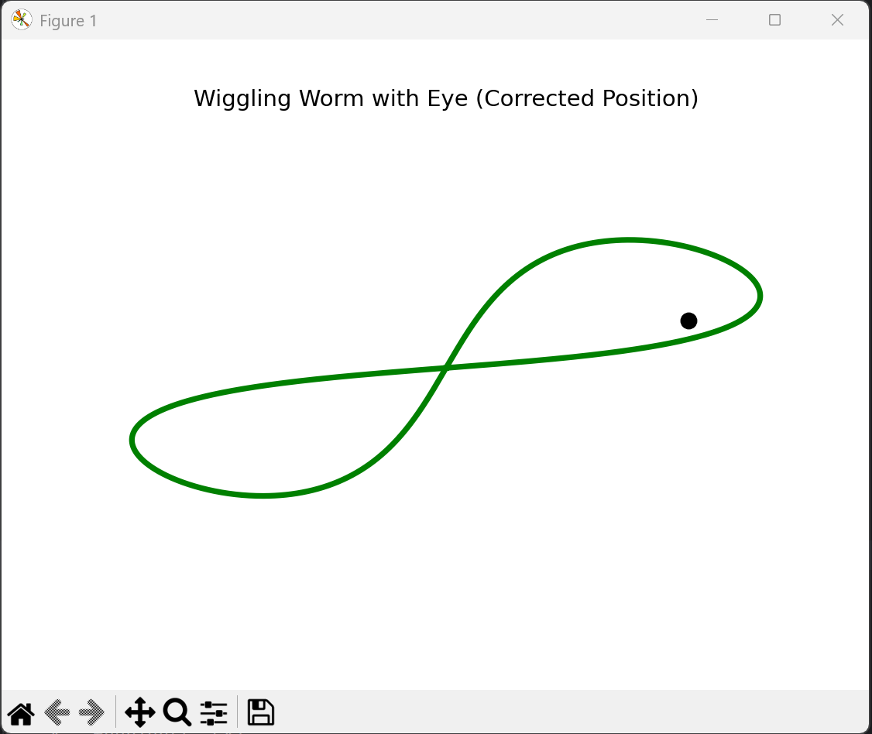
Display our 4 params animals by PyCharm
Outcome

Slide 9
Analysis of house price fluctuations in Hong Kong districts in 2014-2024

Slide 10
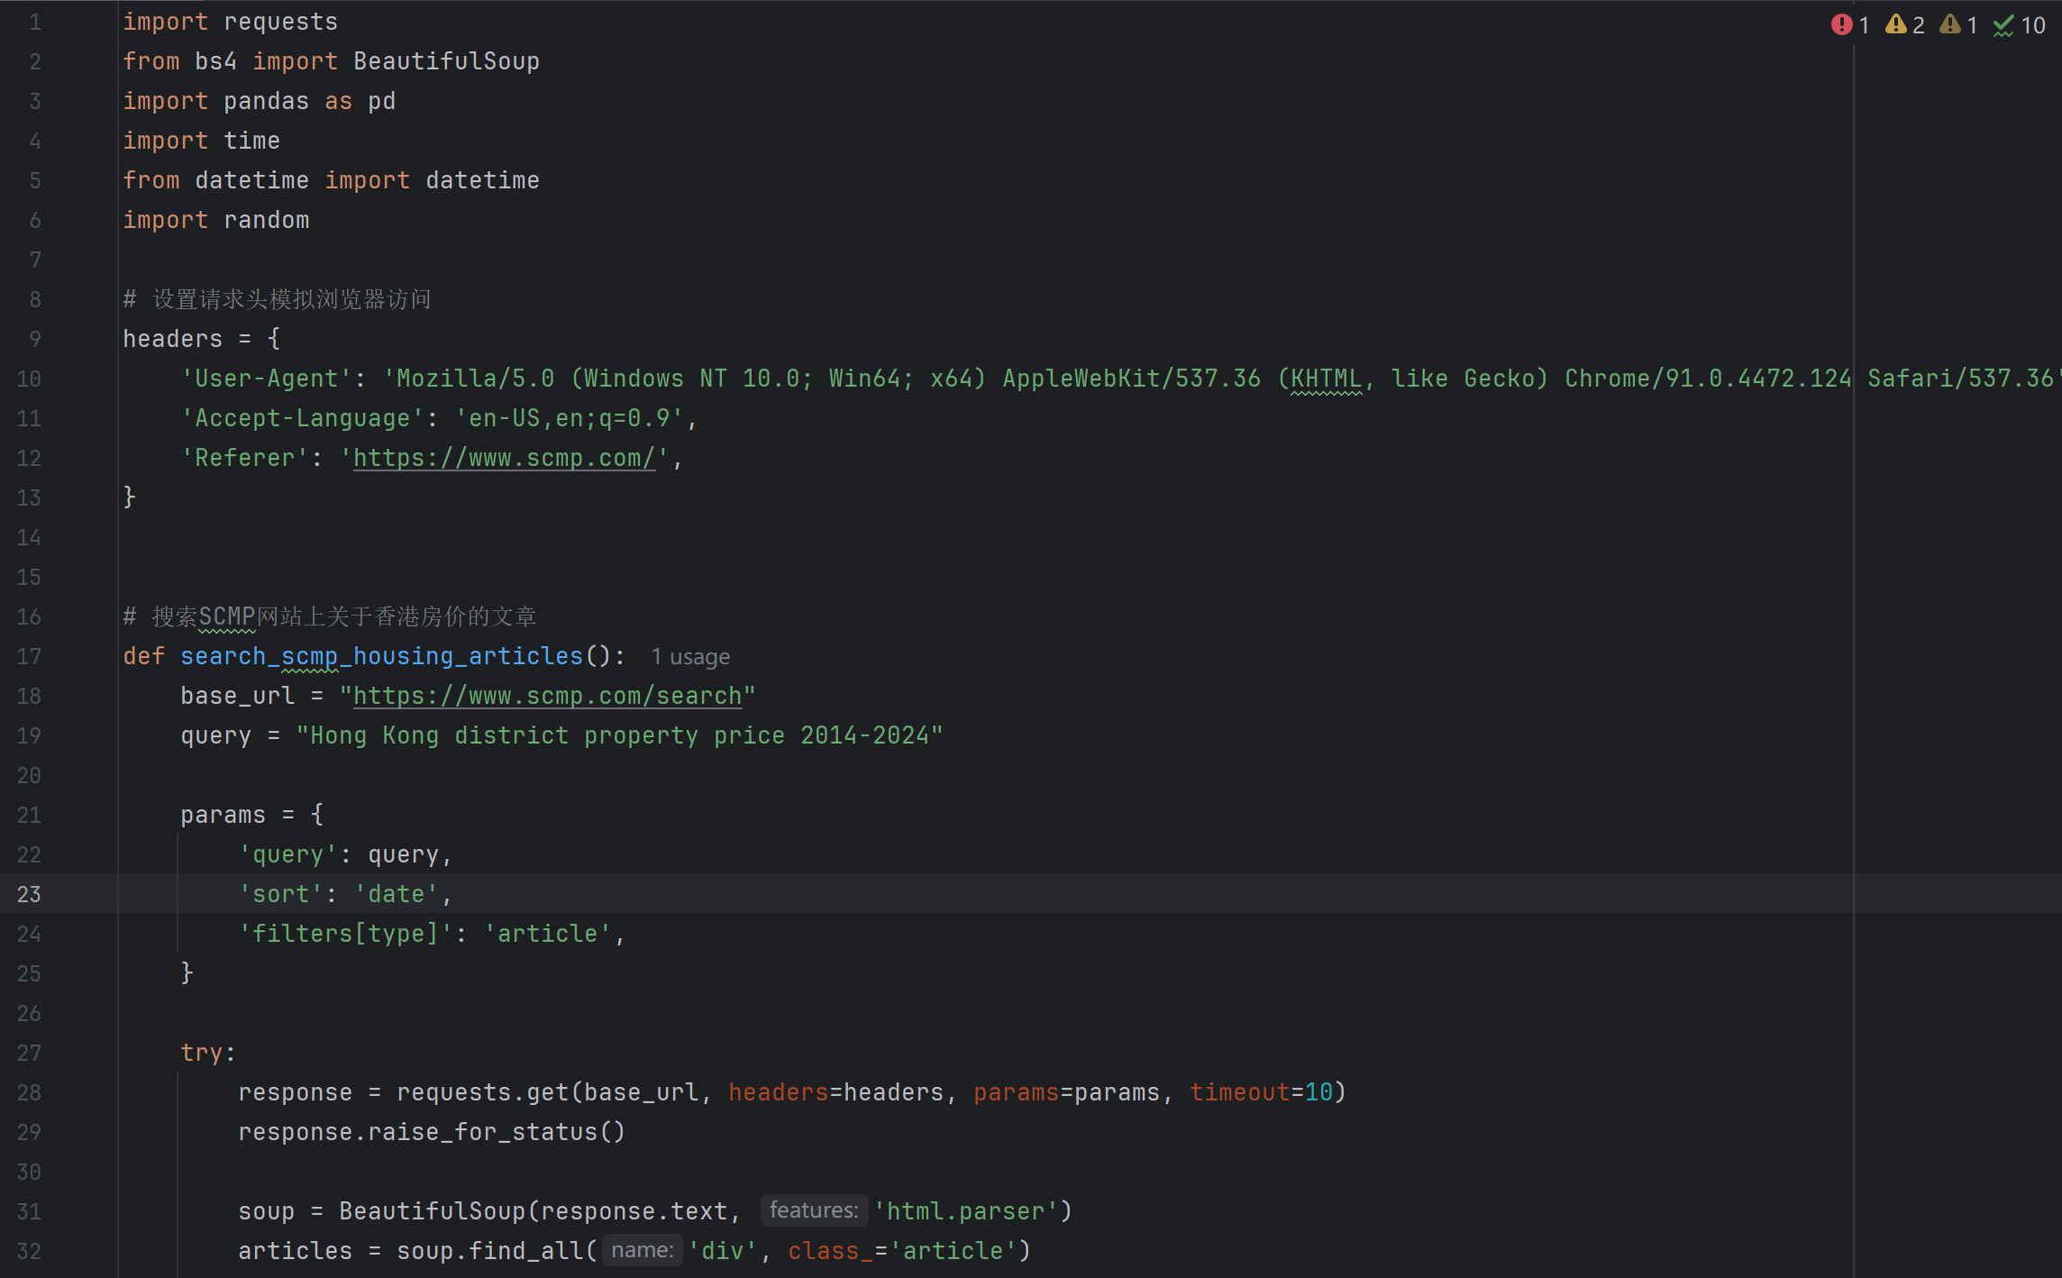
Analysis of house price fluctuations in Hong Kong districts in 2014-2024

Slide 11
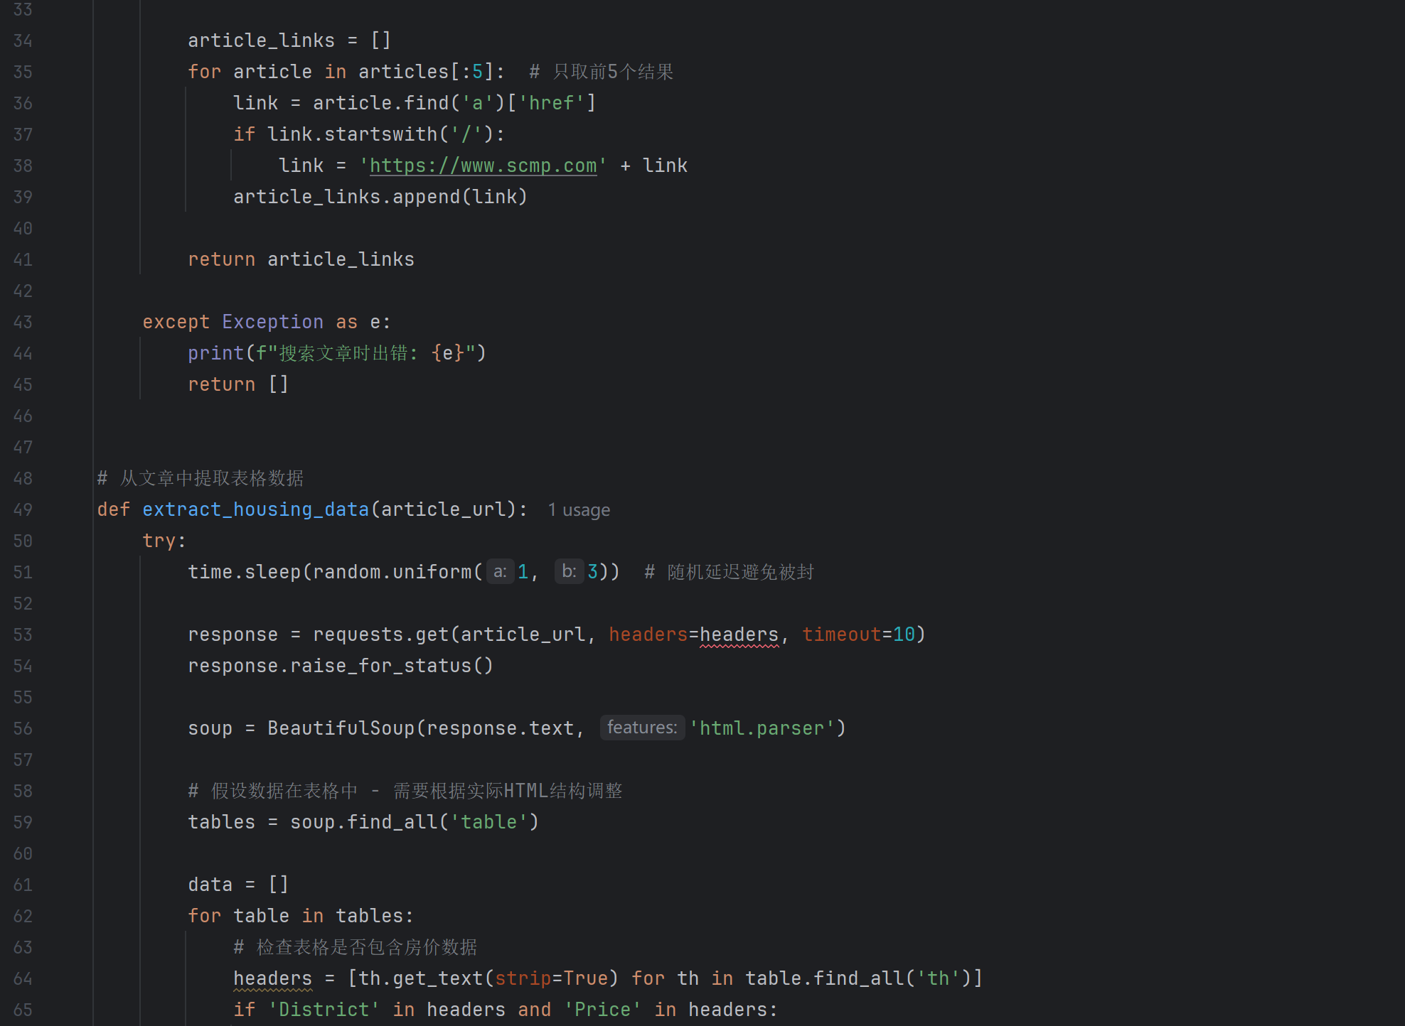
Analysis of house price fluctuations in Hong Kong districts in 2014-2024

Slide 12
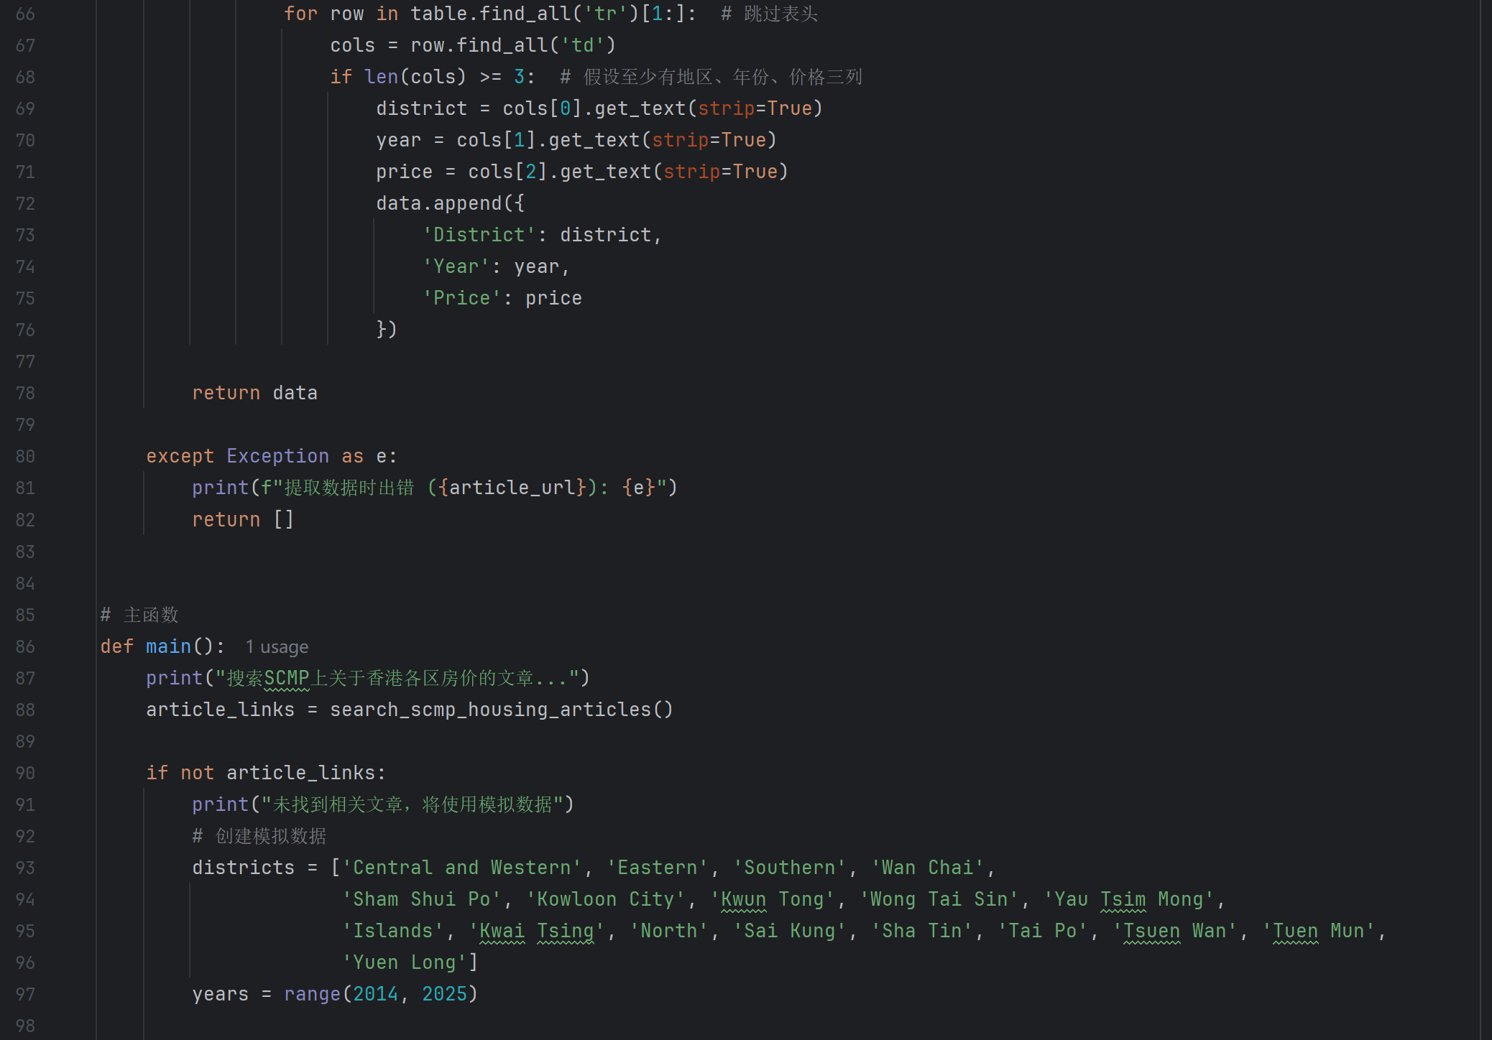
Analysis of house price fluctuations in Hong Kong districts in 2014-2024

Slide 13
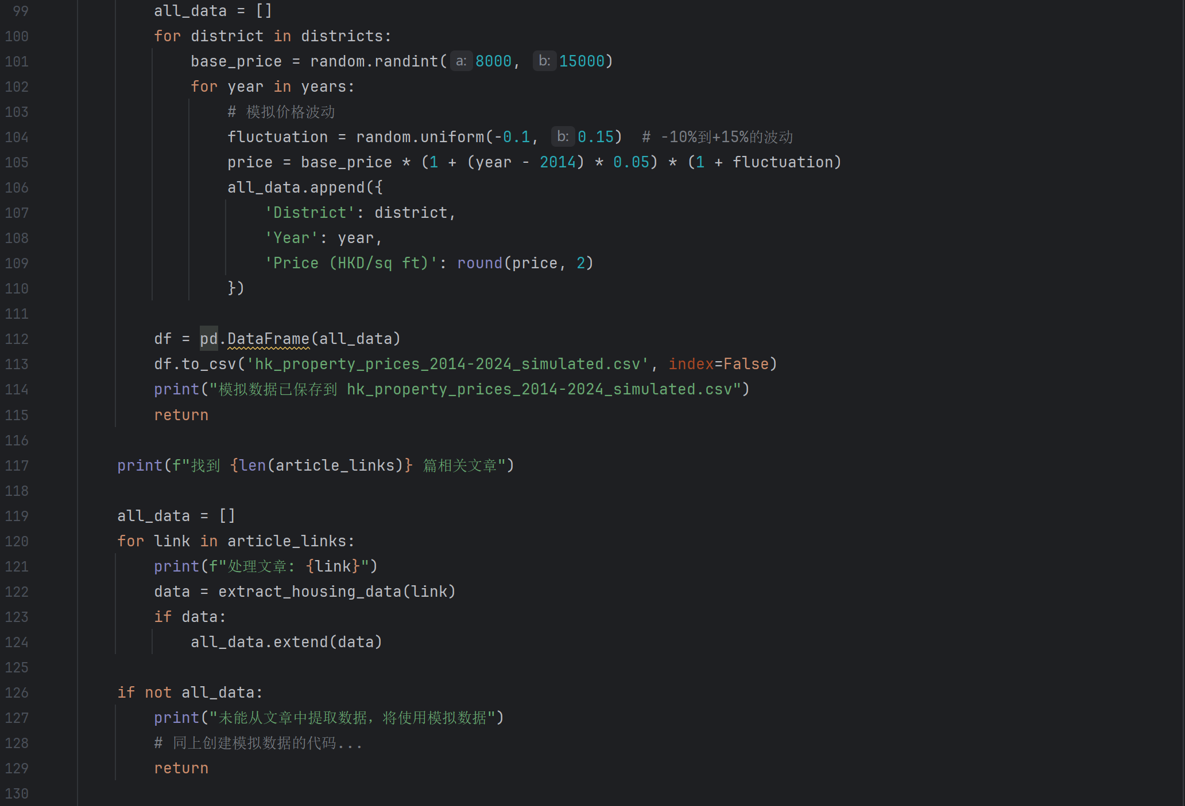
Analysis of house price fluctuations in Hong Kong districts in 2014-2024

Slide 14
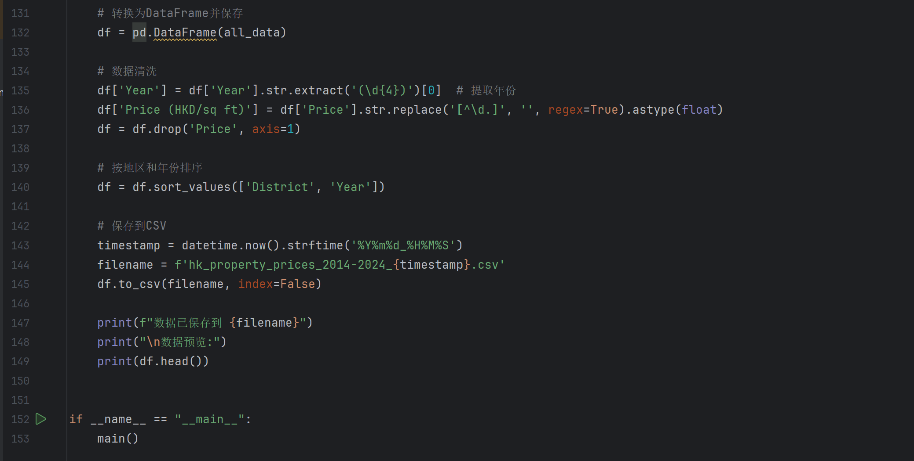
Analysis of house price fluctuations in Hong Kong districts in 2014-2024

Slide 15
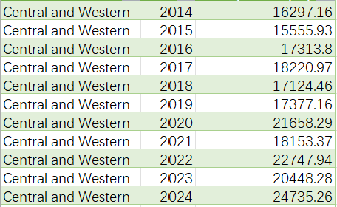
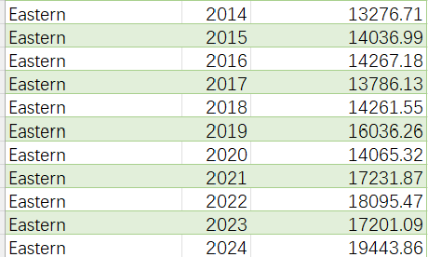
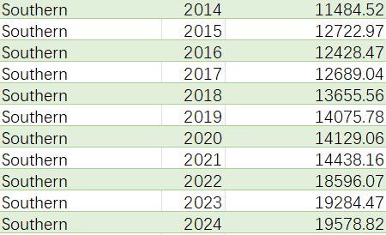
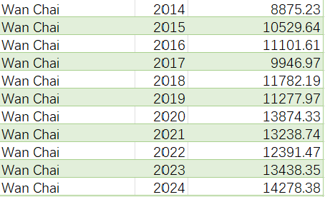
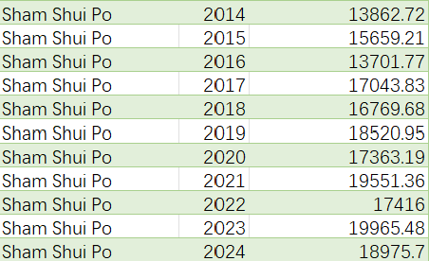
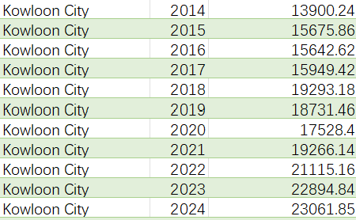
Analysis of house price fluctuations in Hong Kong districts in 2014-2024

Slide 16
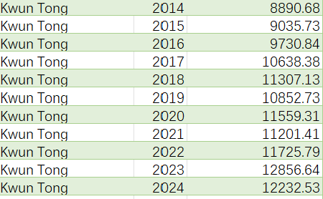
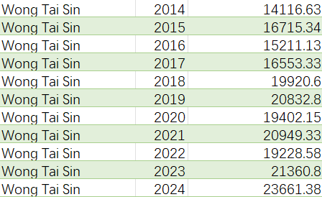
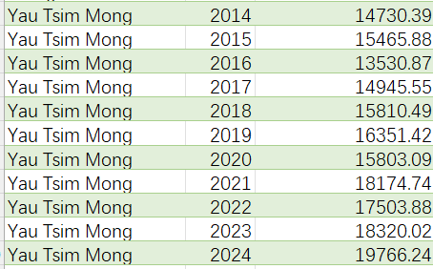
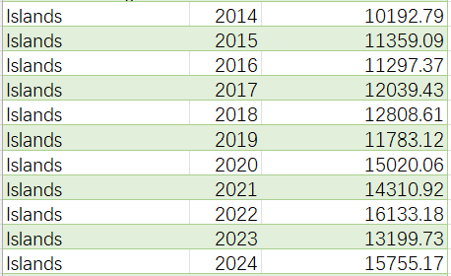
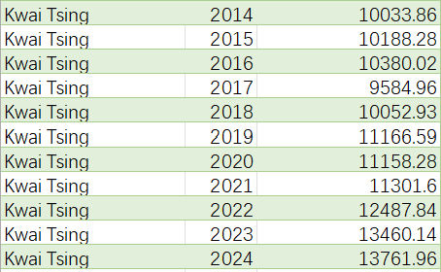
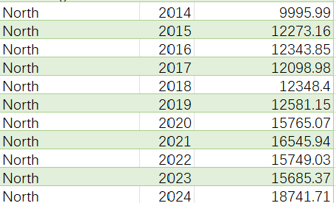
Analysis of house price fluctuations in Hong Kong districts in 2014-2024

Slide 17
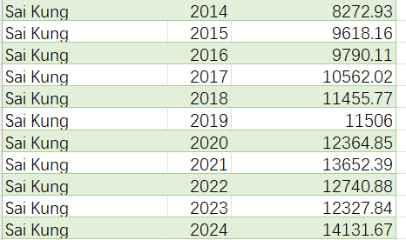
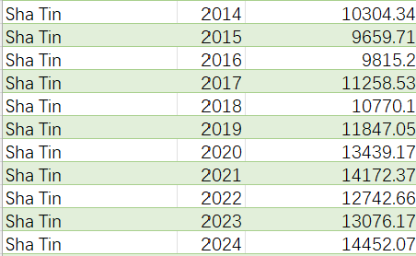
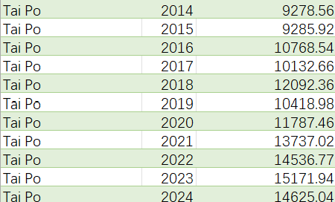
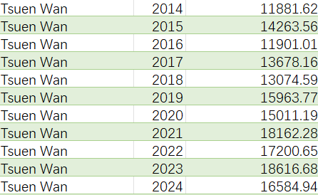
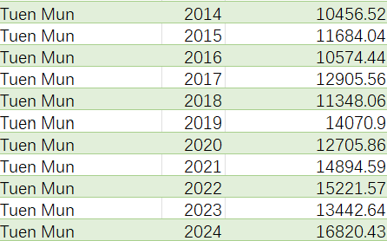
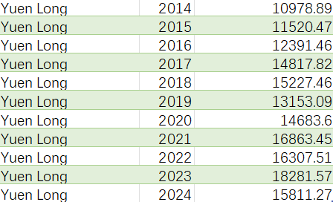
Analysis of house price fluctuations in Hong Kong districts in 2014-2024

Slide 18
Analysis of house price fluctuations in Hong Kong districts in 2014-2024

Slide 19
Analysis of house price fluctuations in Hong Kong districts in 2014-2024

Slide 20
Analysis of house price fluctuations in Hong Kong districts in 2014-2024

Slide 21
Analysis of house price fluctuations in Hong Kong districts in 2014-2024

